Slide 1
How Computer Process Data
Lecture- 7
Tokey Ahmmed
Lecturer, Dept. of CSE
Varendra University

Slide 2
The CPU

Slide 3
Central Processing Unit
the "brain” of the computer
the place where data is manipulated
CPU – Super Computer and Micro Computer
CPU has at least two basic parts:
The Control Unit
The Arithmetic Logic Unit (ALU)

Slide 4
The Control Unit
All the computer’s resources are managed from the control unit.
The control unit is the logical hub of the computer
The CPU's instructions for carrying our commands are built into the control unit.
Think as traffic signal!

Slide 5
What is instructions ?
The instructions, or instruction set, is list of all the operations that the CPU can perform.
Each instruction in the instruction set is expressed in microcode a series of basic directions that tell the CPU how to execute more complex operations.

Slide 6
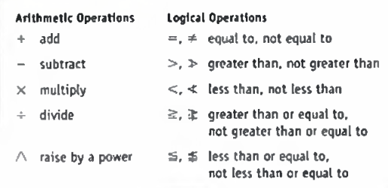
The Arithmetic Logic Unit (ALU)
perform two types of operations:
arithmetic operations
logical operations.
The ALU includes a group of registers
(high-speed memory) built directly into the CPU that are used to hold the data currently being processed.

Slide 7
Control Unit or ALU?
Many instructions carried out by the control unit involve simply moving data from one place to another—from memory to storage, from memory to the printer, and so forth.
When the control unit encounters an instruction that involves arithmetic or logic, however, it passes that instruction to the second com­ponent of the CPU, the arithmetic logic unit, or ALU.
The ALU actually performs the arithmetic and logical operations described earlier.

Slide 8
Machine Cycles
Each time the CPU executes an instruction, it takes a series of steps. The completed series of steps is called a machine cycle.
A machine cycle itself can be broken down into two smaller cycles:
the instruction cycle and
the execution cycle.

Slide 9
The Instruction Cycle
During the instruction cycle, the CPU takes two steps:
Fetching. Before the CPU can execute an instruction, the control unit must retrieve (or fetch) a command or data from the computer' s memory.
Decoding. Before a command can be executed, the control unit must break down (or decode) the command into instructions that correspond to those in the CPU’s instruction set.

Slide 10
The Execution Cycle
At this point, the CPU is ready to begin the execution cycle-
Executing. When the command is executed, the CPU carries out the instructions in order by converting them into microcode.
Storing. The CPU may be required to store the results of an instruction in memory (but this condition is not always required).

Slide 11
Speed
MIPS (Million Instruction Per Second)
BIPS (Billion Instruction Per Second)
Increasing speed using:
Pipelining
Multitasking

Slide 12
Pipelining
In pipelining, the control unit begins a new machine cycle—that is, it begins executing a new instruction—before the current cycle is completed.
Executions are performed in stages:
When the first instruction completes the “fetching” stage, it moves to the “ decode” stage and a new instruction is fetched.

Slide 13
The Memory

Slide 14
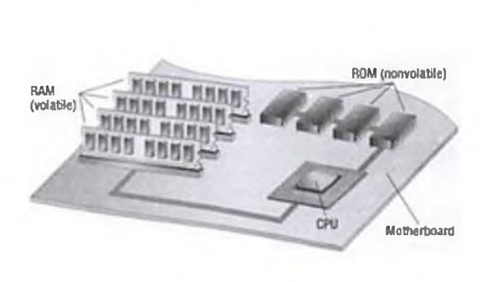
Memory
~ is one or more sets of chips that store data and/or program instructions, either temporarily or permanently.

Slide 15
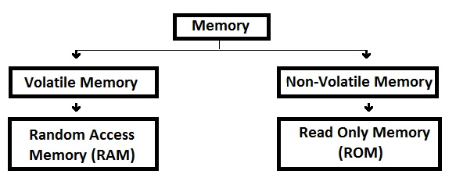
Memory Types
Memory can be majorly categorized into two types:
Volatile Memory
Non-Volatile Memory

Slide 16
Nonvolatile Memory
Nonvolatile chips hold data even when the computer is unplugged.
Burning in the data! - done at the factory
Read Only Memory (ROM) - During normal use, the data in these chips is only read and used —not changed
Programmable Read Only Memory (PROM) Specifically, chips that cannot be changed
Found on- printer and hardware device

Slide 17
Nonvolatile Memory (Cont.…)
They contain the instructions that power the devices. These instructions, once set, never need to be changed.
When a computer is turned on- it must know how to start.
contain –
basic input output system (BIOS)
a set of start-up instructions
set of routines called power on self test (POST), which ensure that the system is functioning properly and all expected hardware devices are present

Slide 18
Flash Memory
Flash memory is a special type of nonvolatile memory. It is often used in portable digital devices for storage.
The flash memory works by having actual switches store the binary values that make up the data.

Slide 19
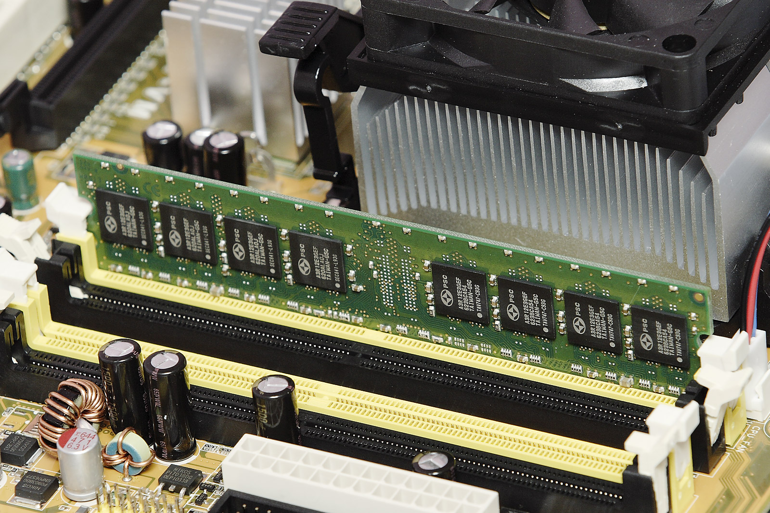
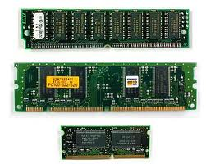
Volatile Memory
Volatile memory requires power to store data.
In a computer is called random access memory (RAM ).
hold programs and data while they are in use
Physically, RAM consists of chips on a small circuit board

Slide 20
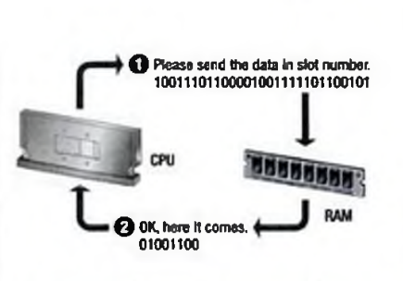
Random Access!
RAM is designed to be instantly accessible by the CPU or programs.
The “random” in RAM implies that any portion of RAM can be accessed at any time.
This helps make RAM very fast.

Slide 21
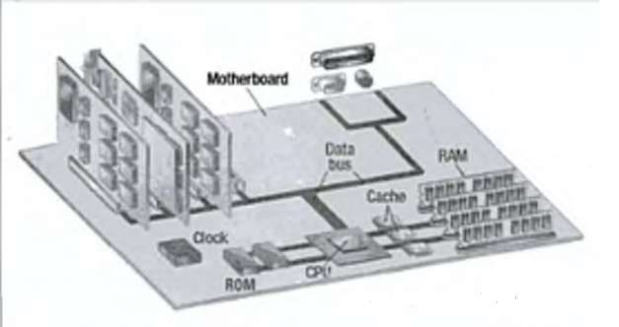
Factors Affecting Processing Speed
Registers size
Cache Memory
Memory and Computing Power
The Computer's Internal Clock
The Bus

Slide 22
Registers
A processor register is one of a small set of data holding unit that are pat of the compute processor
The size of the registers, which is sometimes called the word size, indicates the amount of data with which the computer can work at any given time.
Bigger is better

Slide 23
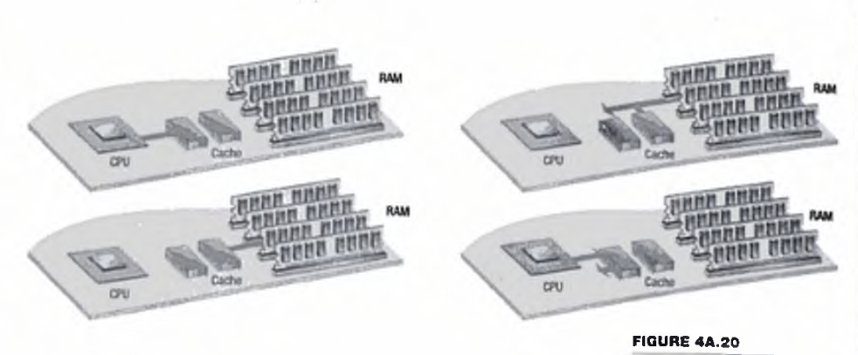
Cache Memory
Cache memory is similar to RAM except that it is extremely fast compared to normal memory and it is used in a different way.

Slide 24
Cache Memory
Level 1 (L1)
Level 2 (L2)
Level 3 (L3) (This motherboard resident cache)
L I, L2, and L3 all speed up the CPU, although in different ways.
L I cache holds instructions that have recently run.
L2 cache holds potential upcoming instructions.
L3 holds many of the possible instructions.

Slide 25
Memory and Computing Power
Swap – effective method
Swapping unused contents of RAM to the hard disk is known as virtual memory.

Slide 26
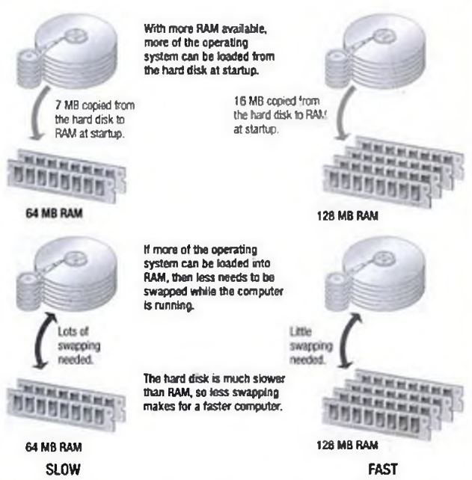

Slide 27
The Computer's Internal Clock
Every microcomputer has a system clock
keep the time of day- not primary duty.
The clock is driven by a quartz crystal.
When electricity is applied, the molecules in the crystal vibrate millions of times per second
The speed of the vibrations is determined by the thickness of the crystal.
The computer uses the vibrations of the quartz in the system clock to time its processing operations.

Slide 28
The computer’s operating speed is tied to the speed of the system clock.
A computer’s clock speed is 800 MHz,
it “ticks” 800 million times per second.
A clock cycle is a single tick, or the time it takes to turn a transistor off and back on again.
A processor can execute an instruction in a given number of clock cycles.
As the system' s clock speed increases, so does the number of instructions it can carry out each second.

Slide 29
The Bus
A bus is a path between the components of a computer.
Two main buses in a computer:
the internal (or system) bus and
the external (or expansion) bus.

Slide 30
The Bus (cont.)
The system bus resides on the motherboard and connects the CPU to other devices that reside on the motherboard.
An expansion bus connects external devices, such as the keyboard, mouse, modem, printer and so on, to the CPU. Cables from disk drives and other internal devices are plugged into the bus.

Slide 31
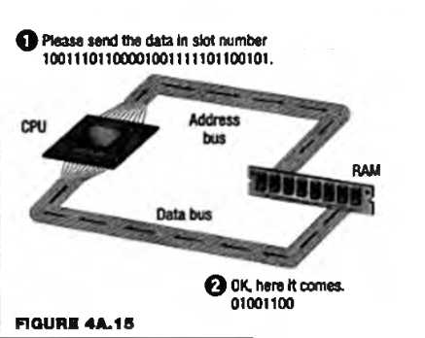
The System Bus
The system bus has two parts:
the data bus and
the address bus

Slide 32
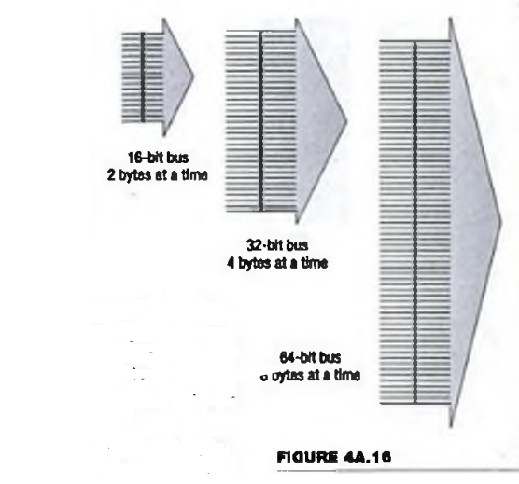
The Data Bus
The data bus is an electrical path that connects the CPU, memory, and the other hardware devices on the motherboard.
Actually, the bus is a group of parallel wires. The number of wires in the bus affects the speed
The bus speed is directly tied into the CPU speed.
Use a multiplier to make the CPU run fasten

Slide 33
The Address Bus
The address bus is a set of wires similar to the data bus.
The address bus connects only the CPU and RAM and carries only memory addresses.
Remember; each byte in RAM is associated with a number, which is its memory address.

Slide 34
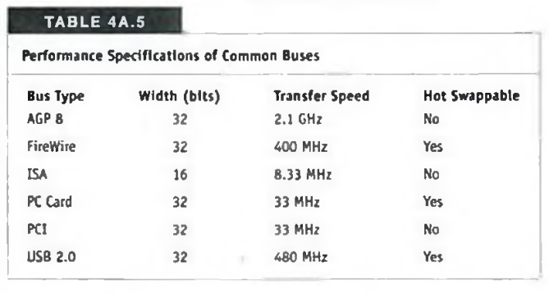
Bus Standards

Slide 35
The End

